Slide 1

PROJECT
Marko Konte

Slide 2
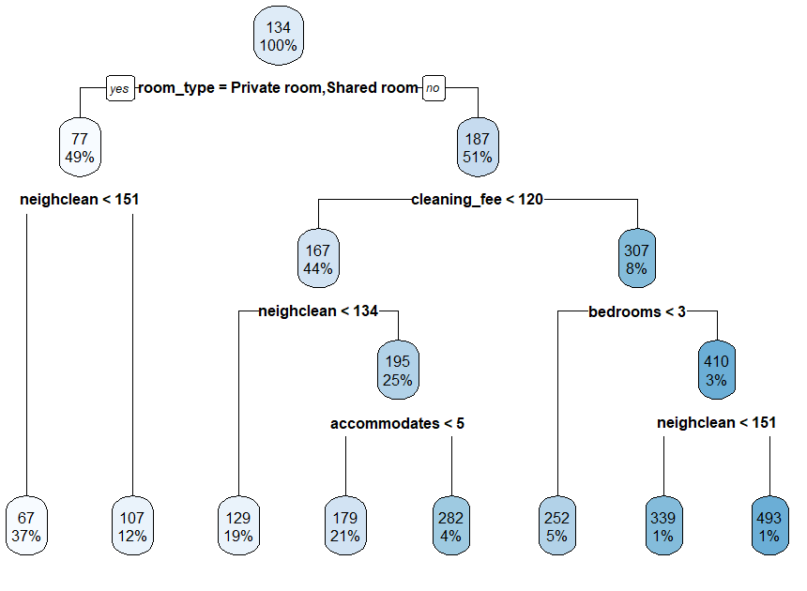
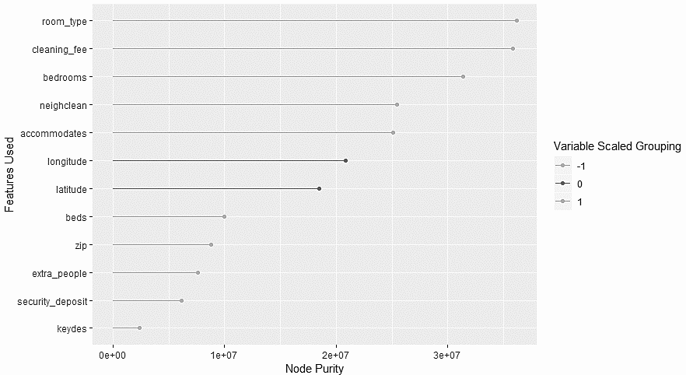
Right
Wrong
EXAMPLE TREE STRUCTURE
Understanding of general theory behind what models to do.
Boosting/ Lasso/ Correlation/ Random Forest/
Cross Validation
Beginning with narrow
‘What sticks’ mentality
On the Right Track
Disorganization with variable
feature selection
Unneeded complexity at times before general
performance measured
Trying out various approaches discussed
throughout semester.
Using both analytical variable discovery with interpretable understanding of data.
Ability to research questions and interpret answers looked up online.
Better understanding of hyper- parameter modification and impact on performance
Shrinkage, learning rate, gamma
Consistent submissions
Progressive improvement in applying class idea’s into implementation.
Applying general theory to code
ROC/ AIC/ Lambda/
Variable manipulation and formatting for
model consumption.
However, simpler was generally better
performer on model.
Skill to create more complex variable error analysis
Multicollinearity/Homoscedasticiy/ Bias v. Variance
Simple variable correlation
measures.
corrplot, tydir
Better understanding of ways to
‘tinker’ with objects in R.
Ability to write useful functions and
tasks.
NODE PURITY
THINGS I WOULD DO DIFFERENTLY NEXT TIME:
TOP DOWN APPROACH WITH VARIABLES
Collect a grouping of variables to dwindle down the most important features first.
DATA TIDYING AND CLEANING UP DATA
Combine top down approach with early focus on cleaning and understanding the data.
USE VISUALIZATION MORE EFFECTIVELY IN EARLY STAGES
Bias v. Variance
Expanding abilities to show individual variable performance.

